Slide 1
HebbSPRT
Hebbian Memory Algorithm for Deep Learning
Zefan Huang
Notes:
Today I will present my algorithm, HebbSPRT, sprt stands for sequential Probability Ratio Test, which is a Hebbian memory algorithm for deep learning.
The main idea is to build a memory layer that can learn stable patterns from the data and then protect those patterns from being overwritten later.

Slide 2
A Hebbian Memory Layer Inside an MLP
Input x
MLP
Learns prediction through supervised learning
MLP₁ → u
HebbSPRT
HebbSPRT → v = uW^{T}
Learns stable memory filters through local updates
Freezes stable filters to reduce forgetting
MLP₂ → ŷ
Notes:
My current algorithm is implemented as a memory layer inserted inside an MLP.
The first part of the MLP (Perceptron) produces a hidden representation, which I call (u). Then, my algorithm learns a set of memory filters and outputs.
This (v) measures how well the current input matches the memory filters that have already been learned.
After that, I can concatenate (u) and (v), and send them into the next part of the MLP for prediction.
The problem is a normal MLP can easily overwrite old structures when it learns new data. In contrast, HebbSPRT can freeze stable filters and turn them into protected memory.

Slide 3
Hebbian Learning: Repeated Activation Writes Memory
Hebbian principle
In HebbSPRT
v = uW^{T} v_{k} = u^{T}w_{k}
Strong co-activation
u hidden representation
w_{k} memory filter
v_{k} activation strength
repeated patterns push filters toward stable directions
stronger connection

Slide 4
The Algorithm Has Three Goals
1
2
3
Detect Activation
Write Structure
Consolidate Memory
v = uW^{T}
Update Function
SPRT + Freeze
Find which filters respond to the input.
Update plastic filters toward non-redundant input structure.
Freeze stable and informative filters.
Notes:
The whole algorithm can be explained through three main steps.
Before going into these steps, I want to clarify what a filter means in this model. A filter is a learned pattern detector in the hidden representation space. Each filter (w_k) stores one possible structure or pattern, and the activation (v_k) tells us how strongly the current input matches that filter. So if (v_k) is large, it means the current input strongly activates that filter.
The first goal is to detect activation. This means the model checks which filters respond to the current input. In other words, it computes (v = uW^\top) to measure the activation strength of each filter.
The second goal is to write structure. For this part, I use an update function to write the input structure into the weights that are not frozen yet. This is where the Sanger-Hebbian update is used. It updates strongly activated filters, but also makes different filters learn different parts of the input, instead of all learning the same dominant pattern.
The third goal is to consolidate memory. Here, I use SPRT to decide which filters have become stable. If a filter is stable and still carries meaningful signal, then it will be frozen.
So, in one sentence, Hebbian learning is responsible for writing patterns into weights, Sanger update helps different filters learn different structures, and SPRT freezing protects stable structures as memory.

Slide 5
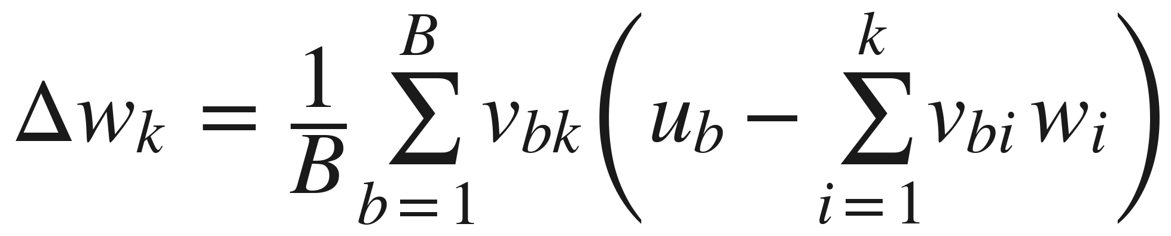
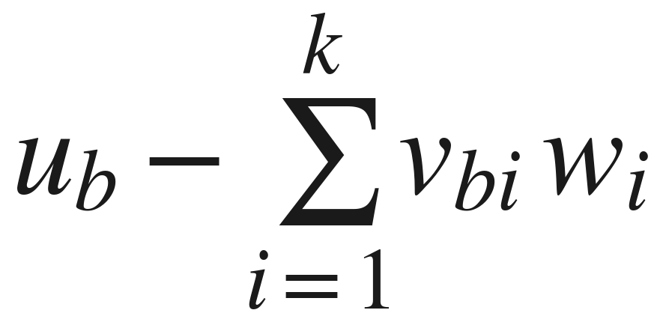
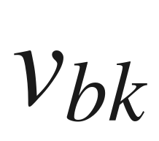
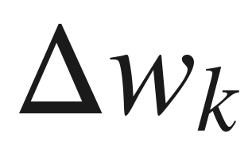
Sanger Update: Hebbian Learning Without Redundancy
Meaning
Meaning
Meaning
The remaining structure not already explained by previous filters. This is the residual.
How strongly filter k responds to sample b. This is the Hebbian signal. Stronger activation means stronger update.
How filter k changes. This is the new memory update for filter k.
Notes:
Plain Hebbian learning has one problem. If there is a very strong pattern in the data, then all filters may learn the same dominant pattern. This wastes memory capacity, because different filters are storing repeated information.
Sanger update solves this problem. It still keeps the main Hebbian idea. However, it adds a residual correction.
The most important part of the formula is the term inside the parentheses: Here, (u_b) is the current input representation. The summation term represents the part that has already been explained by previous filters. So the whole term means the remaining structure that previous filters have not captured yet. This is called the residual.
Then, vbk represents the activation of filter (k) for sample (b). It measures how well the current input matches that filter. Filters with higher activation contribute more to the learning update, while weakly activated filters receive little or no update.
Finally, deltaK is the weighted average of these signals over the batch. Intuitively, it tells us how the (k)-th filter should change and what direction it should learn.
The key takeaway is that Sanger update does not make all filters learn the full input. Instead, the (k)-th filter only learns the part that has not been explained yet, because fo the residutal. This prevents all filters from remembering the same dominant pattern, and allows different filters to store different structures.

Slide 6
SPRT Freezing: From Learned Feature to Protected Memory
Movement
step_{k} = ‖w_{k}^{new} − w_{k}^{old}‖
Drift
d_{k} ← 0.9 d_{k} + 0.1 step_{k}
Gaussian SPRT evidence
ΔLLR_{k} = (hi − lo)(hi + lo − 2d_{k}) / 2σ²
Freeze condition
LLR_{k} ≥ A and v_{k} carries signal
Notes:
After calculating the direction of filter movement, I measure how much each filter actually moved. This is the step size, which is the difference between the new weight and the old weight.
if step size is big it probably means the filter is still learning. If it step size stay small for a long time, then it may have already converged.
However, I do not want to make this decision based on only one movement, because a single update can be noisy. So I define a variable called drift to smooth the movement over time.
here’s the Drift equation, This means the algorithm gives 90 percent weight to the past trend and 10 percent weight to the new movement.
Then, I use SPRT to continuously accumulate evidence.
The Gaussian evidence increment works like this: if the drift is small, the increment becomes positive, which increases the evidence that this filter has become stable. If the drift is large, the increment becomes negative, which reduces that evidence.
When the evidence is above the threshold, and the activation of this filter still has enough variance, it means the filter is not a dead filter. Instead, it really carries useful signal.
At this point, the filter will be frozen. After freezing, this filter will no longer be changed by new data. Therefore, it becomes protected memory.

Slide 7
